Slide 1
EXTERNAL ASSESSMENT
Module#2

Slide 2

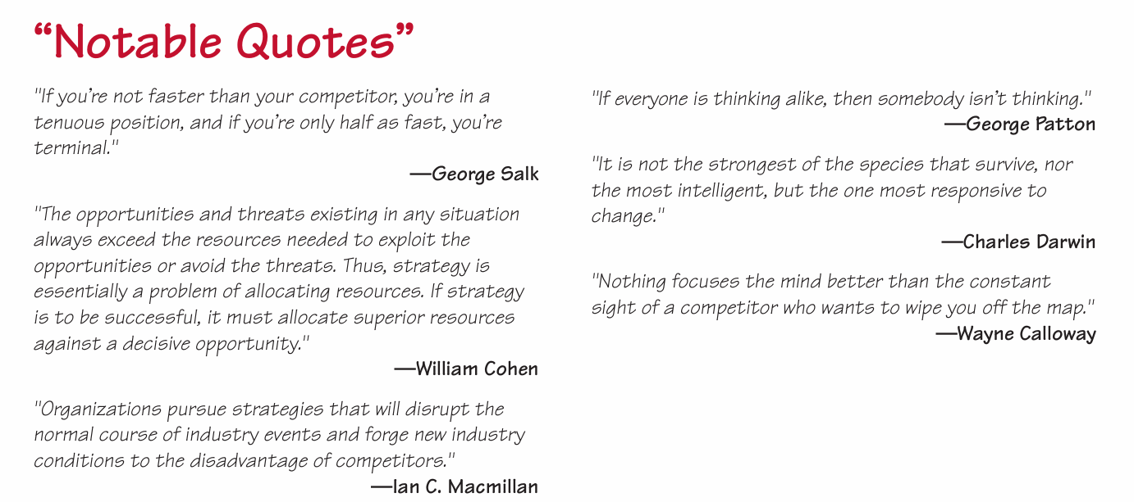

Slide 3
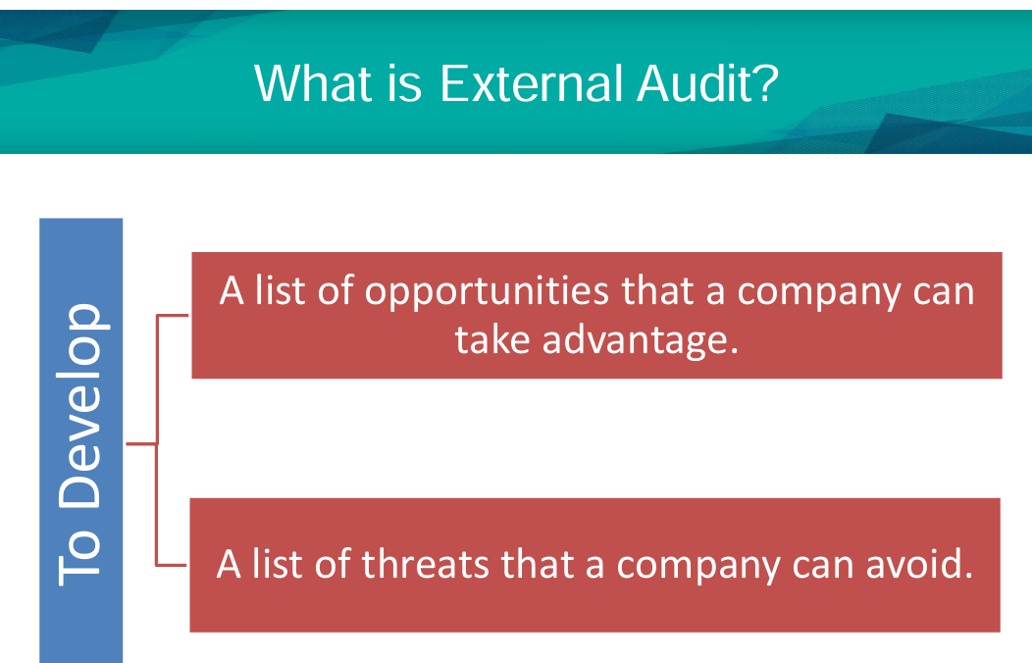

Slide 4
The purpose of an external audit is to develop a finite list of opportunities that could benefit a firm and threats that should be avoided.
It is aimed at identifying key variables that offer actionable responses.
Formulating strategies that take advantage of external opportunities or that minimize the impact of potential threats.

Slide 5
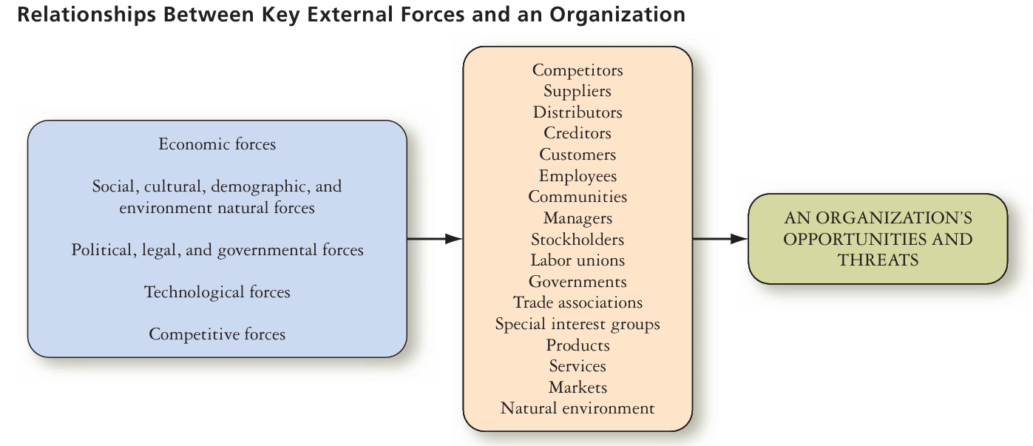

Slide 6
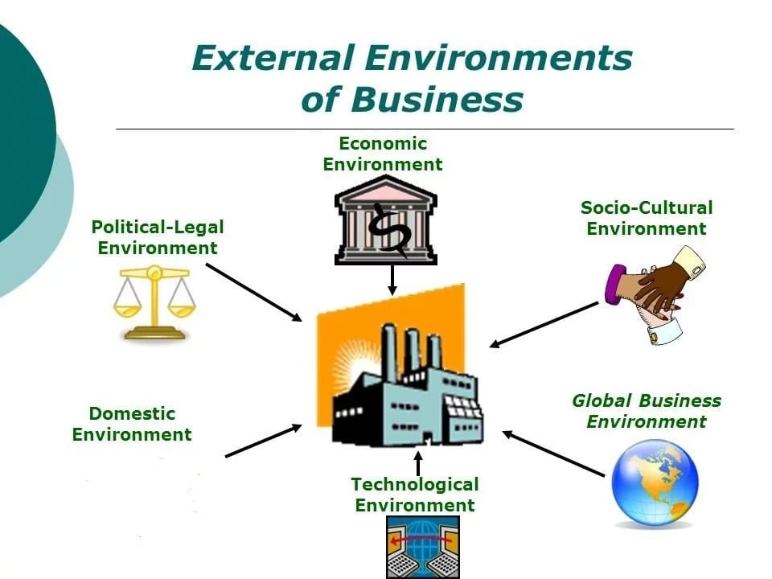
COMPANYS EXTERNAL ENVIRONMENT

Slide 7
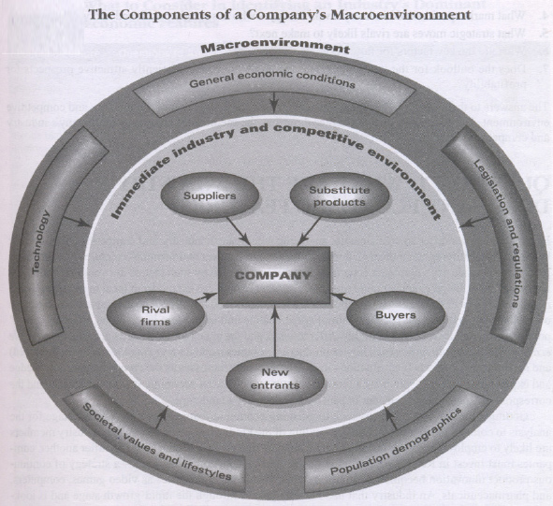

Slide 8
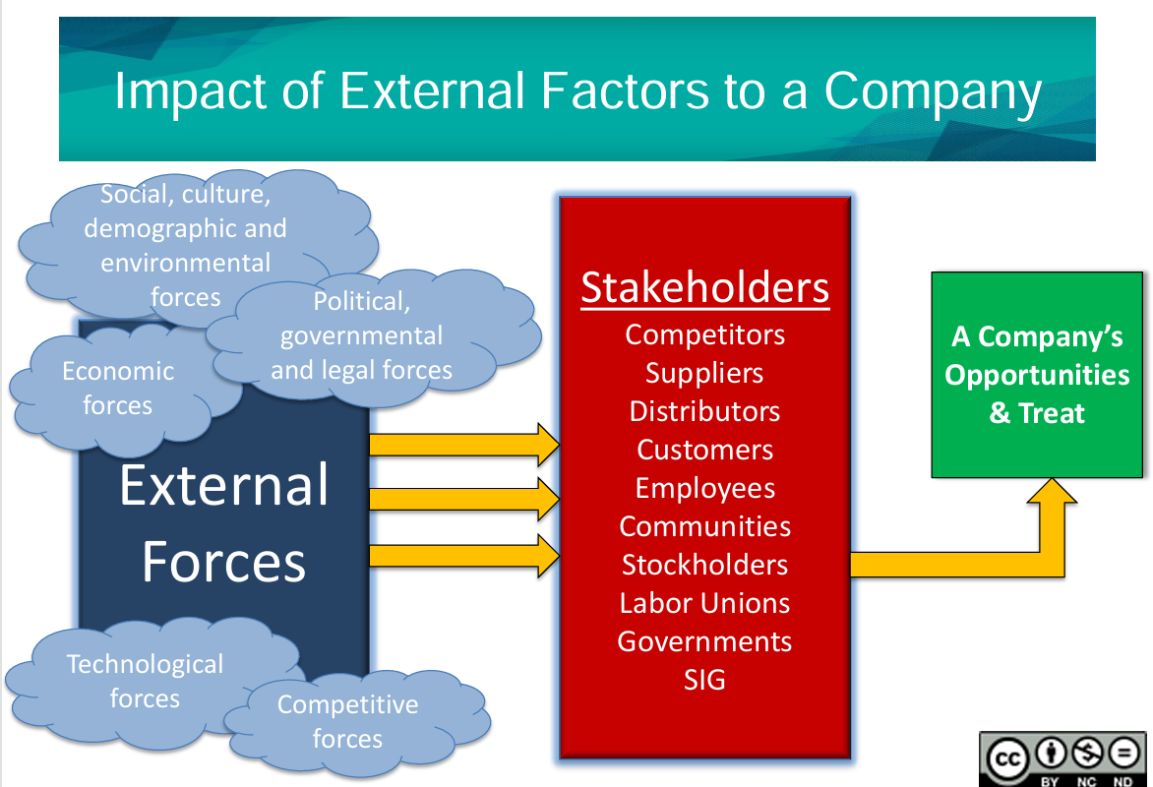

Slide 9
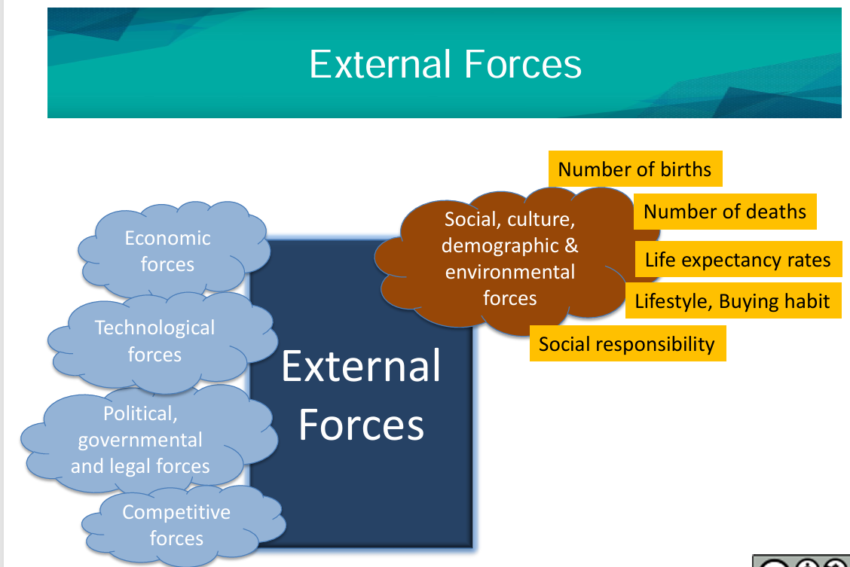

Slide 10
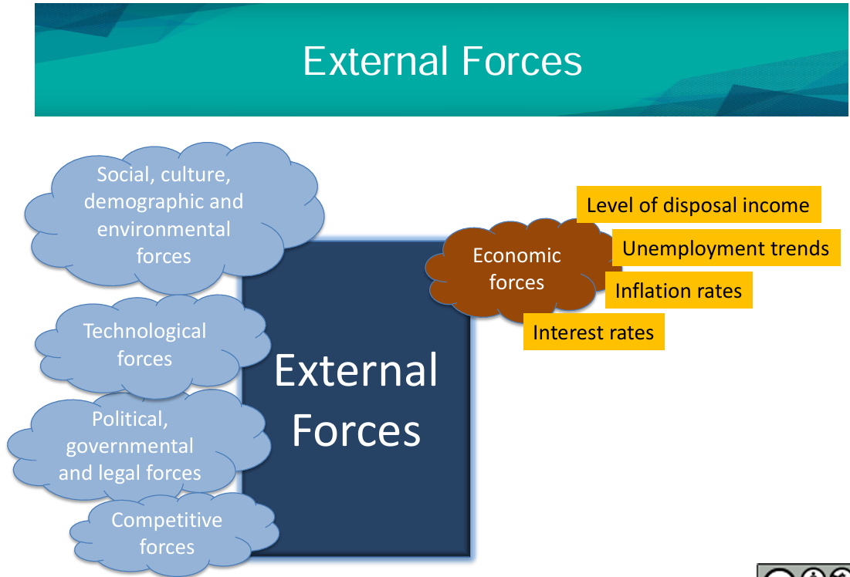

Slide 11
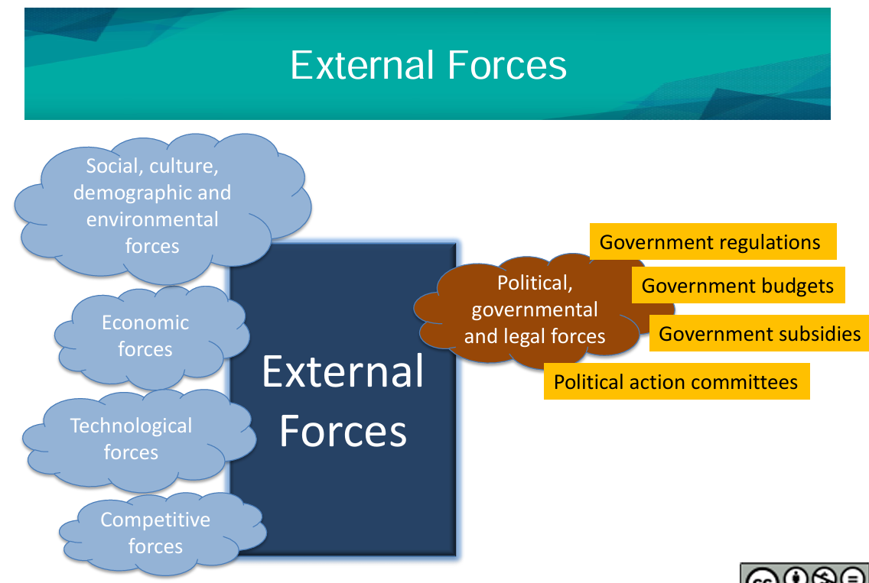

Slide 12
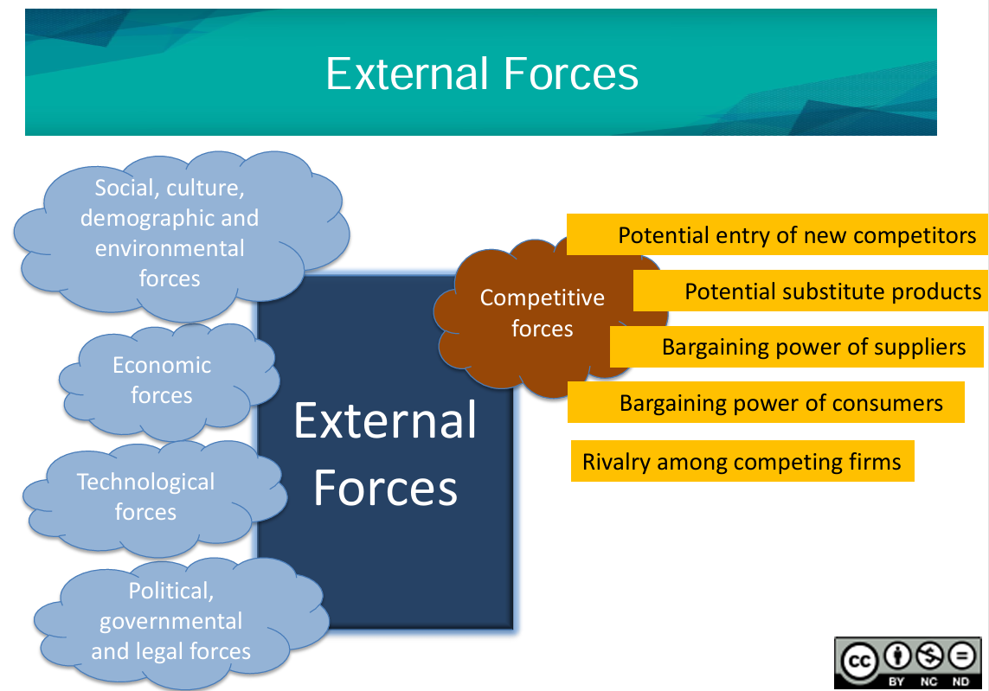

Slide 13
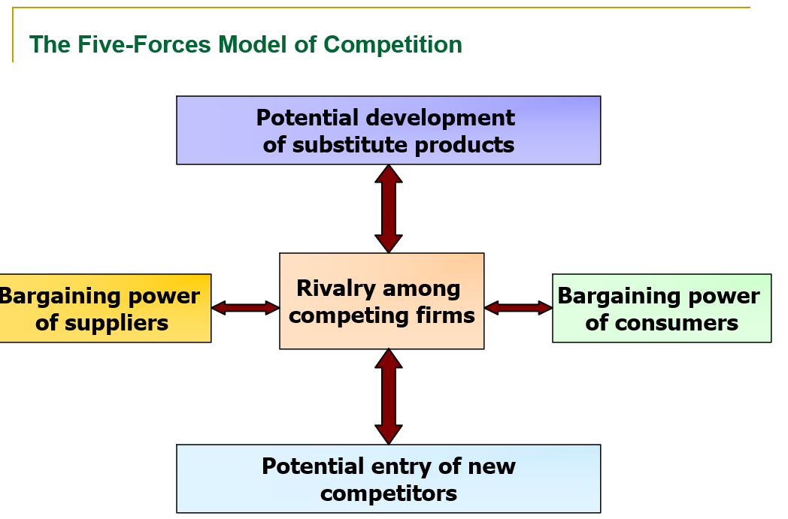

Slide 14
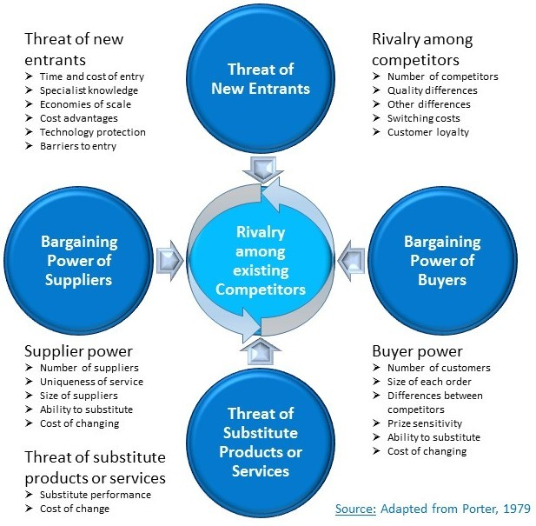
Porters Five Forces Model

Slide 15
Porter's Five Forces model is a powerful tool for analyzing a company's competitive environment. It helps businesses understand the external pressures that can impact their profitability. Case study of Tesla, a globally recognized electric vehicle (EV) company:
Porter's Five Forces Analysis of Tesla
Competitive Rivalry (High) Tesla faces intense competition from traditional automakers like Ford, GM, and Volkswagen, as well as new EV entrants such as Rivian and Lucid. The automotive industry requires constant innovation, making rivalry fierce.
Threat of New Entrants (Moderate to High) High capital requirements and technological expertise create barriers for new entrants. However, the growing demand for EVs and advancements in battery technology are making it easier for new companies to enter.
Bargaining Power of Suppliers (Moderate) Tesla relies on suppliers for key components like batteries, semiconductors, and specialized materials. While Tesla has strong relationships with some suppliers, fluctuations in raw material prices (e.g., lithium) can impact production costs.
Bargaining Power of Buyers (High) Consumers have multiple EV options with varying price points. If Tesla raises prices significantly or experiences quality issues, buyers may switch to competitors, increasing their power in the market.
Threat of Substitutes (Moderate) Alternative transportation options like public transit, hydrogen-powered vehicles, and hybrid cars pose a threat. However, Tesla's strong brand loyalty and innovative technology help mitigate this risk.

Slide 16
Porter's Five Forces applied to Apple;
1.Threat of New Entrants – Apple operates in a highly competitive tech industry with significant barriers to entry, including high capital investment, brand loyalty, and proprietary technology. While new entrants may emerge, Apple's strong ecosystem makes it difficult for them to gain traction.
Bargaining Power of Suppliers – Apple has a global supply chain with multiple suppliers for components like processors, displays, and semiconductors. Due to its scale and influence, Apple maintains strong control over suppliers, reducing their bargaining power.
Bargaining Power of Buyers – Customers have considerable bargaining power, especially in the smartphone and computing markets. However, Apple's differentiation strategy, premium branding, and ecosystem integration help mitigate this force.
Threat of Substitutes – The threat of substitutes is moderate, as consumers can opt for alternative brands or open-source software. However, Apple's seamless integration across devices and services strengthens customer retention.
Industry Rivalry – The tech industry is fiercely competitive, with major players like Samsung, Google, and Microsoft vying for market share. Apple counters this with continuous innovation, strong branding, and a loyal customer base.

Slide 17
Porter's Five Forces applied to SERVICE INDUUSTRY;
1. Competitive Rivalry
Service industries often have high competition due to low switching costs and differentiation challenges.
Example: In the banking sector, numerous institutions offer similar financial services, leading to intense rivalry based on customer experience, digital accessibility, and pricing.
2. Threat of New Entrants
Entry barriers depend on factors like branding, regulatory requirements, and technological investment.
Example: A new consulting firm may struggle to establish credibility against industry giants with established reputations and deep client networks.
3. Bargaining Power of Suppliers
The suppliers in service industries might include technology providers, skilled professionals, and outsourced partners.
Example: In healthcare services, medical equipment manufacturers and pharmaceutical suppliers can influence operational costs and service efficiency.
4. Bargaining Power of Buyers
Customers often have strong negotiating power, especially when many alternatives exist.
Example: In the hospitality sector, travelers can easily compare hotel prices and reviews online, pushing companies to offer competitive rates and superior service.
5. Threat of Substitutes
Substitutes arise when alternative methods fulfill customer needs differently.
Example: Traditional taxi services face competition from ride-sharing platforms like Uber and Ola, altering consumer preferences.

Slide 18
Porter's Five Forces model can be applied to higher education institutions to analyze their competitive landscape and external pressures.
Porter's Five Forces Analysis for Higher Education
Competitive Rivalry (High) Universities and colleges compete for students, faculty, funding, and reputation. The rise of online education and international institutions has intensified this rivalry.
Threat of New Entrants (Moderate to High) New universities, online learning platforms, and specialized institutions can enter the market, especially with advancements in digital education. However, accreditation and infrastructure costs create barriers.
Bargaining Power of Suppliers (Moderate) Suppliers in education include faculty, publishers, technology providers, and government agencies. Universities depend on high-quality faculty and cutting-edge research, making supplier influence significant.
Bargaining Power of Buyers (High) Students and parents seek affordable, high-quality education with strong career prospects. With increasing options (private, public, online), students have the power to choose institutions that best meet their needs.
Threat of Substitutes (High) Alternative learning methods such as online courses, vocational training, corporate-sponsored education, and self-learning platforms (Coursera, Udemy) provide substitutes to traditional university education.

Slide 19
Porter's Five Forces Model significantly impacts healthcare management :
1. Competitive Rivalry → Drives Quality & Innovation
Healthcare providers must differentiate themselves through advanced medical technologies, superior patient care, and cost-effective services.
Impact on Management: Hospitals and clinics invest in state-of-the-art equipment, specialized medical staff, and digital health solutions to remain competitive.
2. Threat of New Entrants → Necessitates Strong Branding & Compliance
New hospitals, telemedicine startups, and wellness clinics challenge traditional healthcare institutions.
Impact on Management: Existing healthcare providers focus on brand reputation, accreditation, and patient loyalty programs to retain their market position.
3. Bargaining Power of Suppliers → Influences Cost & Supply Chain Management
Pharmaceutical companies, medical equipment manufacturers, and technology vendors hold significant power.
Impact on Management: Hospitals and clinics negotiate pricing, build long-term supplier partnerships, and seek alternative vendors to control costs.
4. Bargaining Power of Buyers → Improves Patient-Centric Care
Patients demand better treatment options, affordability, and transparency.
Impact on Management: Healthcare providers enhance digital services (telemedicine, electronic health records), create flexible payment models, and prioritize patient satisfaction.
5. Threat of Substitutes → Encourages Innovation & Holistic Care
Alternative treatments like homeopathy, wearable health devices, and AI-driven diagnostics compete with traditional healthcare.
Impact on Management: Hospitals integrate preventive healthcare, wellness programs, and personalized treatments to address evolving patient preferences.
Overall Impact:
Healthcare managers must constantly adapt to market dynamics, regulate pricing models, improve service delivery, and foster innovation. The industry is shifting toward value-based care, where patient outcomes and satisfaction dictate success more than volume-based services.

Slide 20
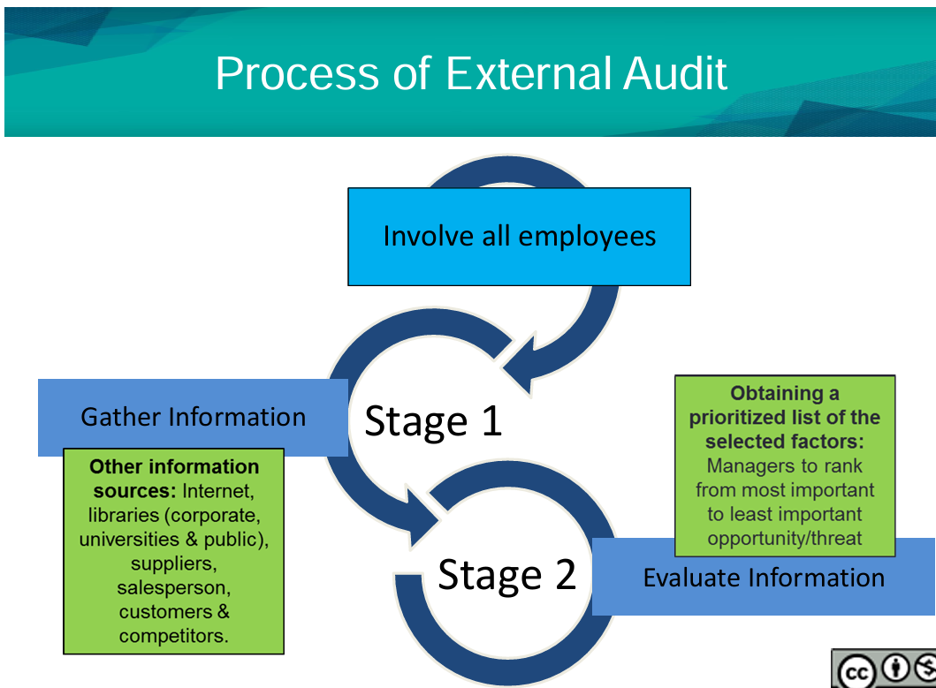

Slide 21
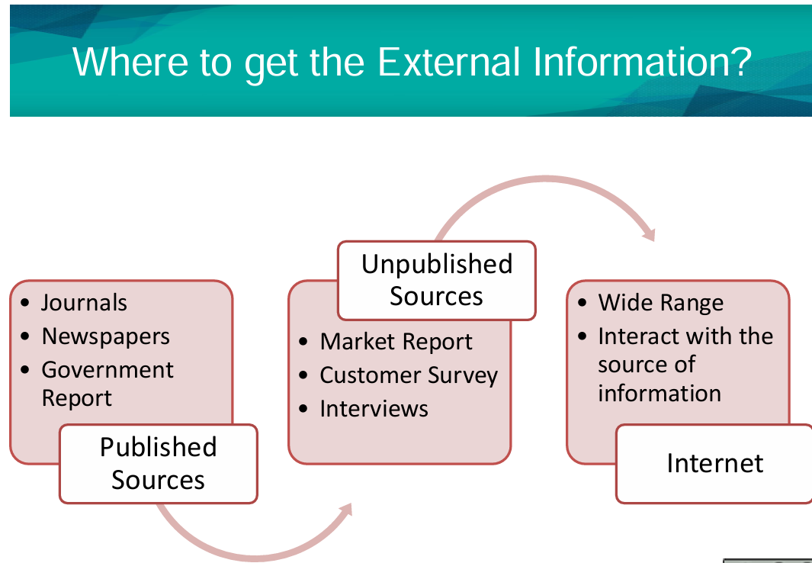

Slide 22
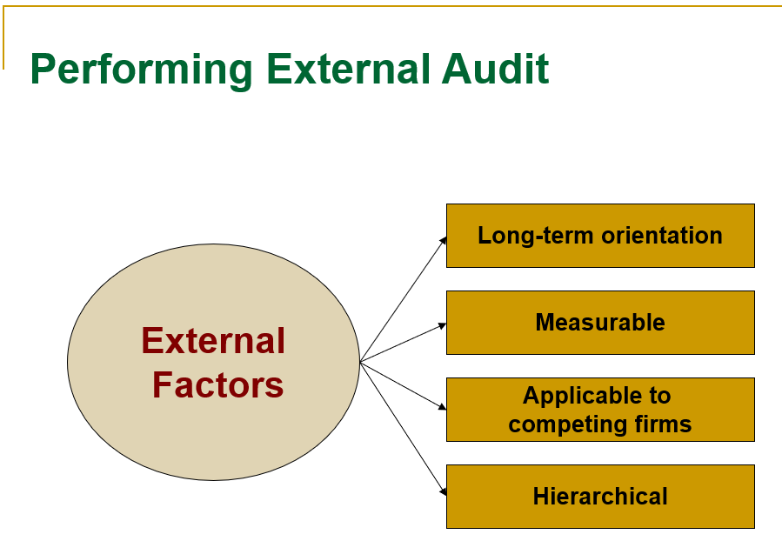
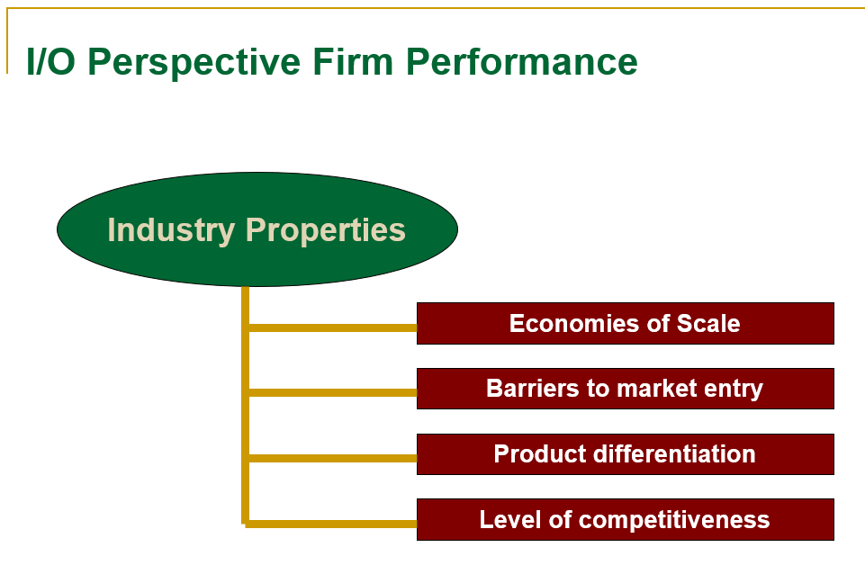

Slide 23
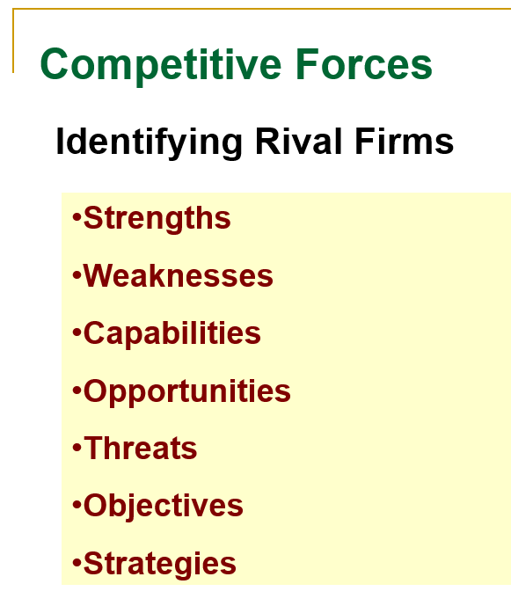

Slide 24
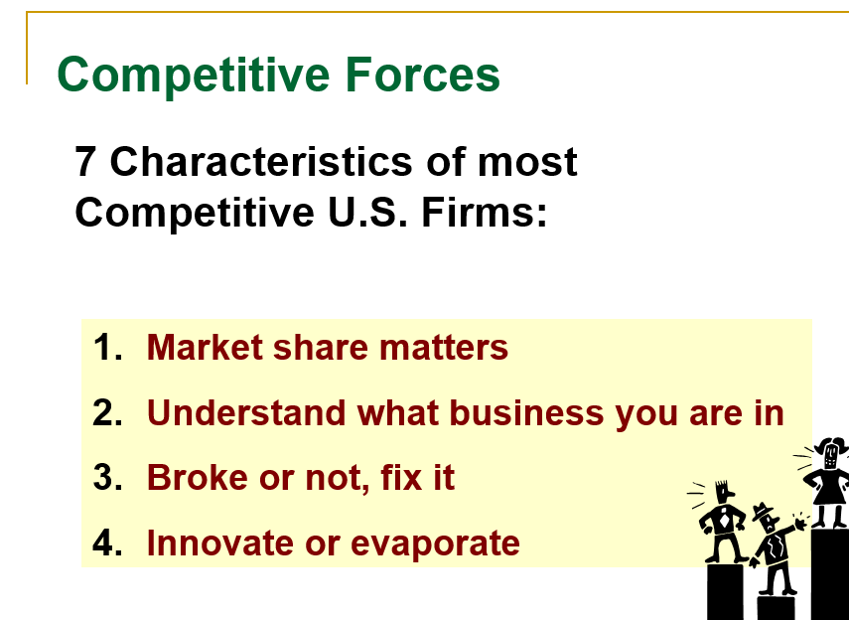
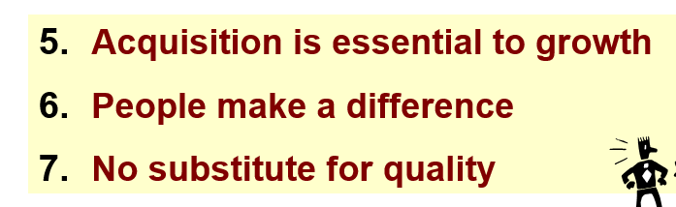

Slide 25
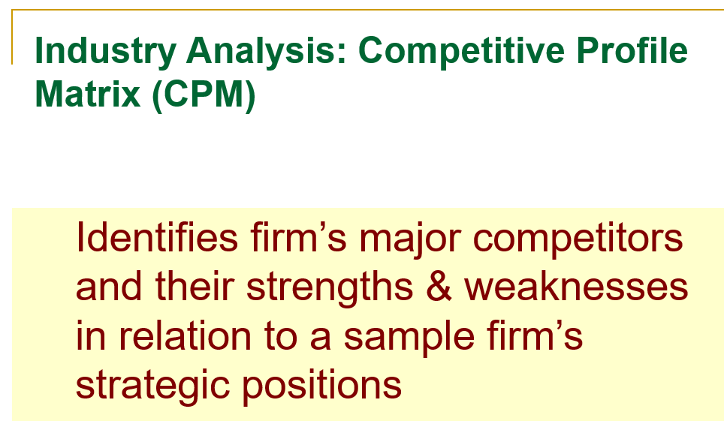

Slide 26
The macro environment factors are
  In the outer ring:
  Societal values and lifestyles e.g. McDonalds not using beef in India
  Population demographics e.g. Insurance companies designing products for young population in India
  Legislation and regulations e.g. No FDI in sectors like retail
  General economic conditions e.g. cost cutting by companies
  Technology e.g. companies using video-conferencing
  The immediate industry and competitive environment factors like:
  Rival firms e.g. Bajaj planning low-priced car
  New entrants e.g. ITC entering FMCG sector
  Buyers e.g. reduction in sales of Pepsi and Coke after pesticide controversy
  Substitute products e.g. bikes replacing scooters
  Suppliers e.g. arm twisting by Microsoft to include Internet Explorer

Slide 27
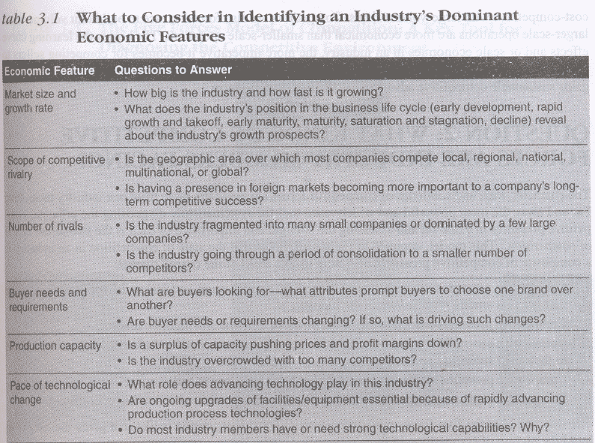

Slide 28
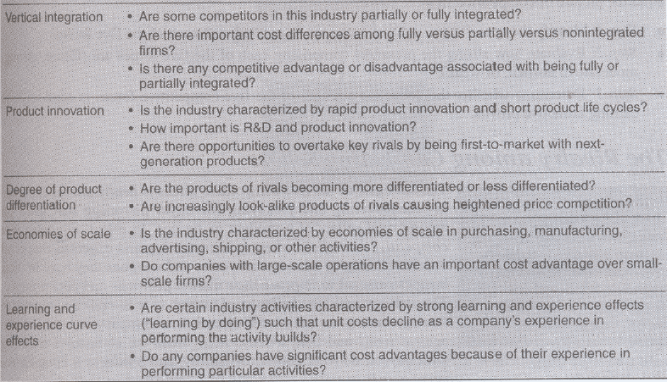
`

Slide 29
Analyzing the industry's distinguishing economic features helps in understanding the kind of strategic moves that industry members are likely to employ
  In a highly product innovative industry like video games, computers and pharmaceuticals the focus in on R&D
  An industry with recent rapid growth looks for cost reduction and improved customer service
  Semiconductor industry gains by learning/experience and is driven to pursue increased sales volumes and capture the resulting cost saving economics

Slide 30
What factors are driving industry change and what impacts will they have?
All industries are characterized by trends and new developments that produce change. E.g. introduction of sachet in FMCG, Nano
The life cycle of an industry - take off, rapid growth, early maturity, market saturation and stagnation or decline -E.g. telecom connectivity industry is driven by wireless connectivity.
Driving forces are those that have the biggest influence on what kind of changes will take place in the industry's structure and competitive environment. E.g. 3G spectrum auction will affect wireless service providers

Slide 31
Identifying an industry's driving forces
Growing use of the internet E.g. opening online booking by railways helped credit card providing and processing companies
Increasing globalization. E.g. software, jewellery
Changes in the long-term industry growth rate. E.g. oral medicines like oral insulin and oral H1N1 drug in pharmaceutical industry
Changes in who buys the product and how they use it. E.g. travel industry affected by growing number of aged travelers
Product innovation. E.g. pharmaceutical industry
Technological change and manufacturing process innovation. E.g. Toyota manufacturing system, drop in call charges drives the BPO industry
Marketing innovation. E.g. Introduction of sachet in FMCG
Entry or exit of major firms. E.g. Retail industry
Diffusion of technical know-how across more companies and more countries. E.g. software industry
Changes in cost and efficiency. E.g. wireless service industry

Slide 32
Assessing the impact of the driving forces
The assessment of whether the sum effect of all the forces is making the industry more or less attractive can be done by asking the following questions:
Are the driving forces causing demand for the industry's product to increase or decrease? E.g. low cost cars will increase demand for cars, health awareness will decrease consumption of carbonated drinks
Are the driving forces acting to make competition more or less intense? E.g. foray into rural markets reduced competition in that sector for FMCG
Will the driving forces lead to higher or lower industry profitability? E.g. low cost airlines lower industry profitability

Slide 33
Link between driving forces and strategy
Sound analysis of the industry's driving forces is a prerequisite to sound strategy making.
Understanding the forces driving of an industry change and the impacts these forces will have on the character of the industry environment and on the company's business.

Slide 34
What are the key factors for future competitive success?
An industry's Key Success Factors (KSF) are those competitive factors that most effect industry members' ability to prosper in the market place.
They can be - the strategy(defense suppliers), product attributes (mobile sets), resources (steel, cement), competencies, competitive capabilities (FMCG) and market achievements.
Identifying KSFs is a top priority analytical and strategy-making consideration.
An industry's KSFs can be deduced from the analysis of the industry and competitive environment.

Slide 35
Answer to the following questions help identify an industry's Key Success Factors:
1. On what basis do buyers of the industry's product choose between the competing brands of sellers? What attributes of competitors' product offerings are crucial?
2. Given the nature of competitive rivalry and the competitive forces prevailing in the marketplace, what resources and competitive capabilities does a company need to have to be competitively successful? E.g. scale of production in automobile, distribution network in FMCG
3. What shortcomings are almost certain to put a company at a significant competitive disadvantage? e.g. lack of raw material in cement and steel industries

Slide 36
Technology related KSFs & Implementation
Expertise in a particular technology or in scientific research (important in pharmaceuticals, internet applications, mobile communications, and most high tech industries)
Proven ability to improve production processes (important in industries where advancing technology opens the way for higher manufacturing efficiency and lower production costs) e.g. using ERP packages
Distribution related KSFs:
A strong network of wholesale distributors/dealers
Strong direct sales capabilities via the internet and/or having company-owned retail outlets e.g. makemytrip.com, yatra.com
Ability to secure favorable display space on retailer shelves

Slide 37
Manufacturing related KSFs & Implementation
Ability to achieve scale economies and/or capture learning curve effects (important to achieving low production costs) e.g. Tata Motors
Quality control know- medical equipments.
High labor productivity (important for items with high labor content) e.g. software sector in India

Slide 38
Marketing related KSFs & & Implementation
Fast, accurate technical assistance e.g. BPO sector
Courteous, personalized customer service e.g. Hospitality industry
Accurate filling of buyer orders (few back orders or mistakes)e.g. Online ordering system of Dell
Customer guarantees and warranties e.g. Chevrolet promise of no service charges for 3 years
Clever advertising e.g. FMCG sector

Slide 39
Skills and capability related KSFs & Implementation
A talented workplace (superior talent is important in professional services like accounting and investment banking)
National or global distribution capabilities
Product innovation capabilities (important in industries where rivals are racing to be first to market with new product attributes or performance features) e.g. Pharmaceutical
Design expertise (important in fashion and apparel industries)
Short-delivery-time capability e.g. Advertising
Supply chain management capabilities e.g. FMCG, Automobiles
Strong e-commerce capabilities -

Slide 40
Case Study
Amul – Implementing Key Success Factors
Company: Amul (Anand Milk Union Limited)
Industry: Dairy/FMCG
Founded: 1946
Headquarters: Anand, Gujarat
Type: Cooperative, managed by Gujarat Cooperative Milk Marketing Federation (GCMMF)

Slide 41
1. Strong Supply Chain Integration
Amul created a three-tier cooperative structure involving milk producers, village societies, and district unions.
This model ensures direct procurement from farmers, reducing middlemen and increasing farmer income.
Impact: Ensures consistent milk supply and cost efficiency.

Slide 42
2. Brand Trust and Recognition
The iconic "Amul Girl" mascot and campaigns like "Utterly Butterly Delicious" built massive consumer trust.
Amul is known for consistent
Impact: Strong brand recall across urban and rural India.

Slide 43
3. Product Diversification and Innovation
From basic dairy products (milk, butter, ghee) to ice creams, cheese, chocolates, and beverages, Amul has expanded across categories.
Launched products like Amul Kool, Amul Gold Milk, and Camel Milk to cater to niche and health-conscious markets.
Impact: Increased market share and customer base.

Slide 44
4. Low-Cost Leadership
By cutting out middlemen and operating as a cooperative, Amul passes profits back to farmers while keeping prices low for consumers.
Efficient operations and large-scale production help reduce costs.
Impact: Competitive pricing without compromising quality.

Slide 45
5. Distribution Network
Amul has a vast cold-chain logistics and retail network that enables pan-India delivery of perishable dairy products.
Products are available in urban supermarkets, rural kirana stores, and online platforms.
Impact: Availability in over 1,500 towns and villages across India.

